Slide 1

SOFTWARE ENGINEERING
Information Technology
Object Oriented Programming Concepts in C#

Slide 2


1. Classes and Objects
2. 4 Pillars of OOP
3. Inheritance
4. Encapsulation
5. Abstraction
6. Polymorphism

Slide 3
Classes and Objects
Here are the key features of OOP:
Object Oriented Programming (OOP) is a programming model where programs are organized around objects and data rather than action and logic.
OOP allows decomposing a problem into many entities called objects and then building data and functions around these objects.
A class is the core of any modern object-oriented programming language such as C#.
In OOP languages, creating a class for representing data is mandatory.
A class is a blueprint of an object that contains variables for storing data and functions to perform operations on the data.
A class will not occupy any memory space; hence, it is only a logical representation of data.

Slide 4
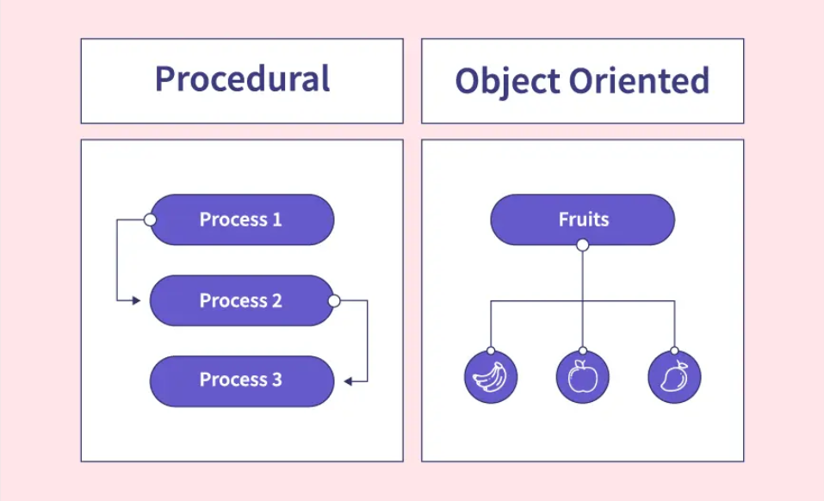
Classes and Objects
Here are the key features of OOP:
So first we have to understand what OOPS is, and how it differs from procedural programming
In Procedural programming, we are applying methods and procedures to data while OOP is about creating objects that can contain data as well as methods.
Procedural programming is based on an unreal world
Object-oriented programming is based on the real
world
We learn logic building through procedural
programming like C Language while for real-world implementation we are using OOP like C#, Java, etc.

Slide 5
Classes and Objects
What is Class?
Class is a template/blueprint for the Objects. It defines object behavior (in the form of class methods) and object attributes (in the form of properties or class data members).
A software system may consist of many classes (A real-time system may have a thousand or more classes). Working with so many classes is not so easy, so we require some way so that they can be managed properly or efficiently.
In order to manage so many classes and to reduce the complexity, system designers use several techniques that can be grouped under four main concepts Encapsulation, Abstraction, Inheritance, and Polymorphism. (more on this later)
A class will not occupy any memory space. Hence to work with the data represented by the class, you must create a variable for the class, which is called an object.

Slide 6
Classes and Objects
What is an Object?
The software is divided into several small units called objects. The data and functions are built around these objects.
An object's data can be accessed only by the functions associated with that object.
The functions of one object can access the functions of another object.
Objects are the basic run-time entities of an object-oriented system. They may represent a person, a place, or any item the program must handle.
"An object is a software bundle of related variables and methods.“
"An object is an instance of a class."

Slide 7
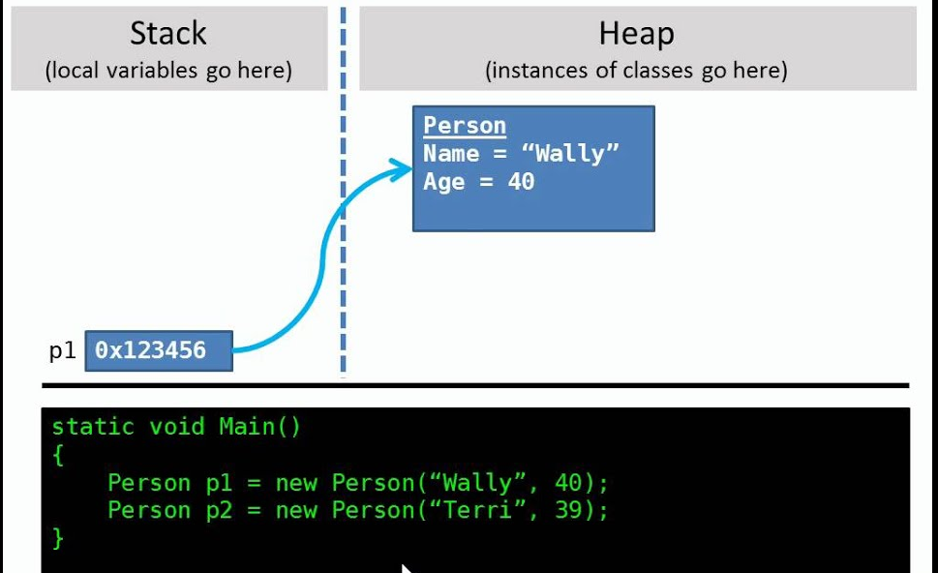
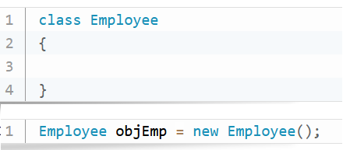
Classes and Objects
What is an Object?
When an object is created using the new operator, memory is allocated for the class in a heap, the object is called an instance, and its starting address will be stored in the object in stack memory.
When an object is created without the new operator, memory will not be allocated in a heap; in other words, an instance will not be created, and the object in the stack will contain the value null.
When an object contains null, it is impossible to access the class members using that object.

Slide 8
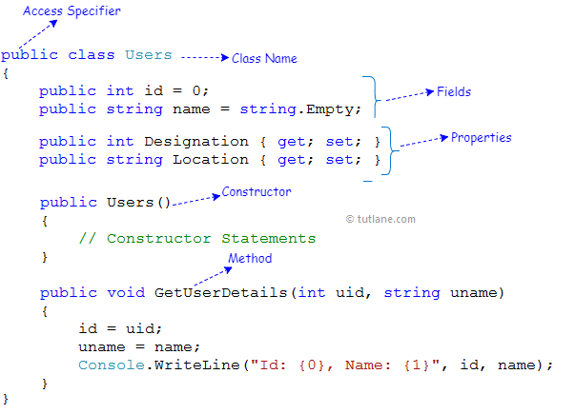
Classes and Objects
Example:

Slide 9
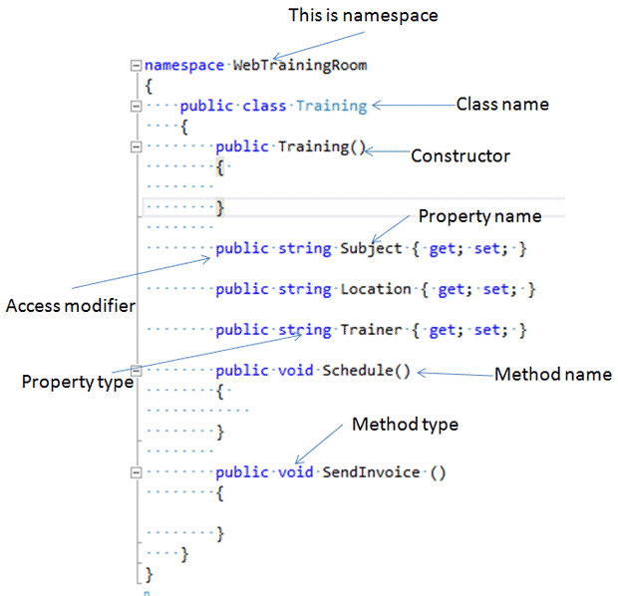
Classes and Objects
Example: namespace
Notes:
A namespace in C# is a way to organize and group related classes, interfaces, enums, and other types. It helps avoid naming conflicts and makes the code more maintainable and understandable. Think of it as a folder structure for your code.

Slide 10
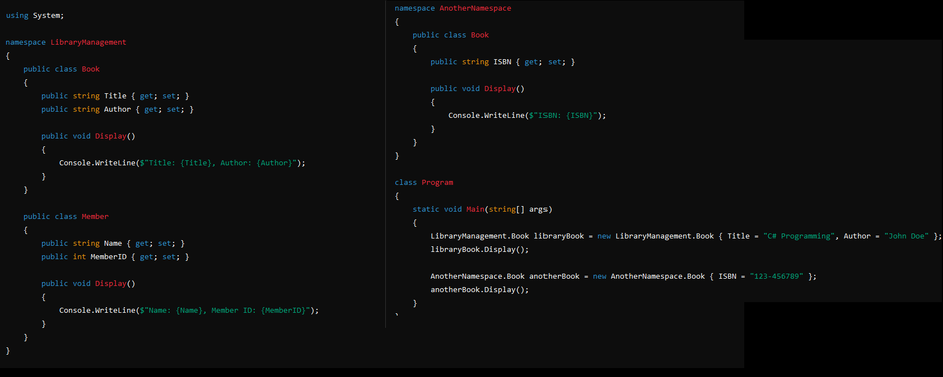
Classes and Objects
Example: namespace
Notes:
A namespace in C# is a way to organize and group related classes, interfaces, enums, and other types. It helps avoid naming conflicts and makes the code more maintainable and understandable. Think of it as a folder structure for your code.

Slide 11

Classes and Objects
What is the static keyword?
11

Slide 12
Classes and Objects
What is the static keyword?
The static keyword is used to denote that an attribute or method belongs to the class itself, rather than an instance of a class.
Methods, attributes, and even classes can be given the static keyword.
Note, we will focus on methods and attributes in this lesson, as static classes are beyond the scope of this module.
When to use static methods:
Getter and setter methods for static attributes
Utility classes such as Math or Collections
12

Slide 13
Classes and Objects
What is the static keyword?
In methods, the static keyword must be used somewhere before the return type:
In variables, the static keyword must be used somewhere before the data type:
Static variables and methods are accessed directly from the class:
public static void MethodName() {}
static public void MethodName() {}
public static int variableName;
static public int variableName;
ClassName.MethodName();
ClassName.variableName;

Slide 14
Classes and Objects
Static variable example
A single variable value needs to be shared amongst all objects of the class.
public class ParkingSpace {
private static int numberOfAvailableSpaces = 0;
public ParkingSpace() {
numberOfAvailableSpaces++;
}
public static int GetNumberOfSpaces() {
return numberOfAvailableSpaces;
}
}

Slide 15

4 Pillars of OOP
The four pillars of Object-Oriented Programming (OOP) are essential concepts that provide a framework for designing and implementing software. These pillars are encapsulation, inheritance, polymorphism, and abstraction.
C# is an object-oriented programming language.

Slide 16
Inheritance
What Is Inheritance?
The process of creating a new class by extending the existing class is called inheritance or the process of inheriting the features of the base class is called inheritance.
The existing class is called the base class and the new class which is created from it is called the derived class.
Also → CHILD and PARENT
Benefits/Advantages Of Using Inheritance
The most important advantage of inheritance is code re-usability.
In Inheritance the derived class possesses all attributes/properties and functions of the base class, this is where code re-usability comes into the picture.
So no need to write the same function and attributes of the base class in the derived class.
Note. Private members of the base class also get inherited in the derived class but they are not accessible in the derived class!

Slide 17
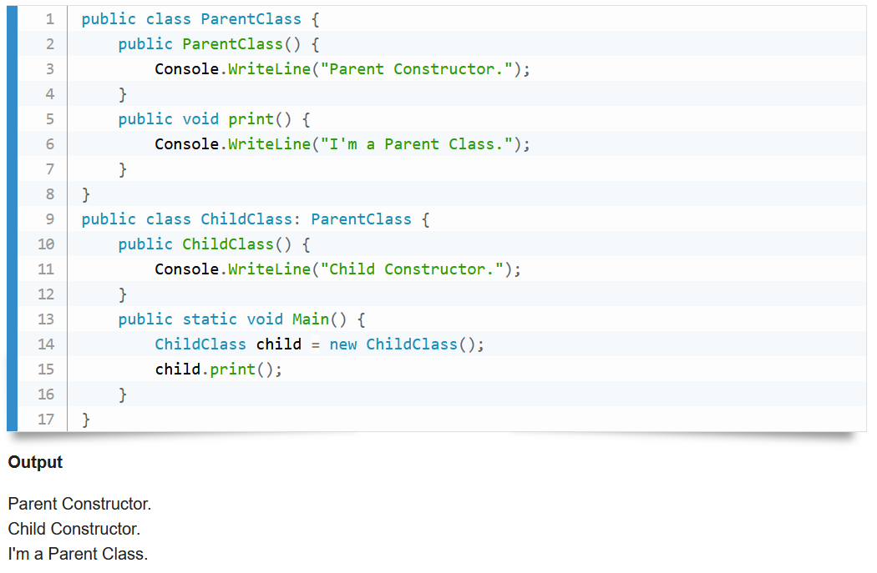
Inheritance
What Is Inheritance?

Slide 18
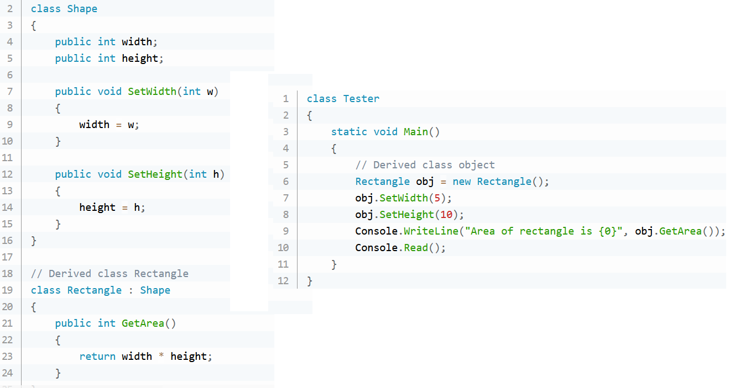
Inheritance
What Is Inheritance?

Slide 19
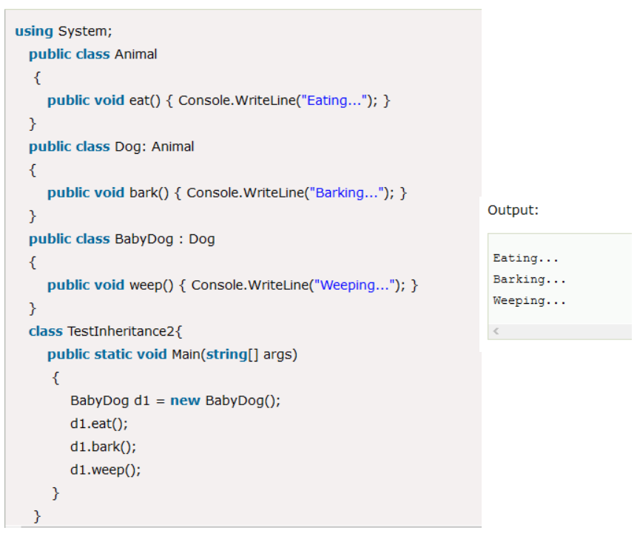
Inheritance
What Is Inheritance?

Slide 20
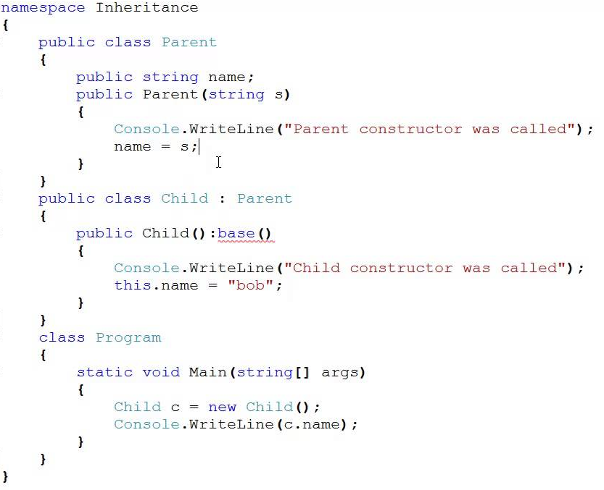
Inheritance
What Is Inheritance – How to use constructors?

Slide 21
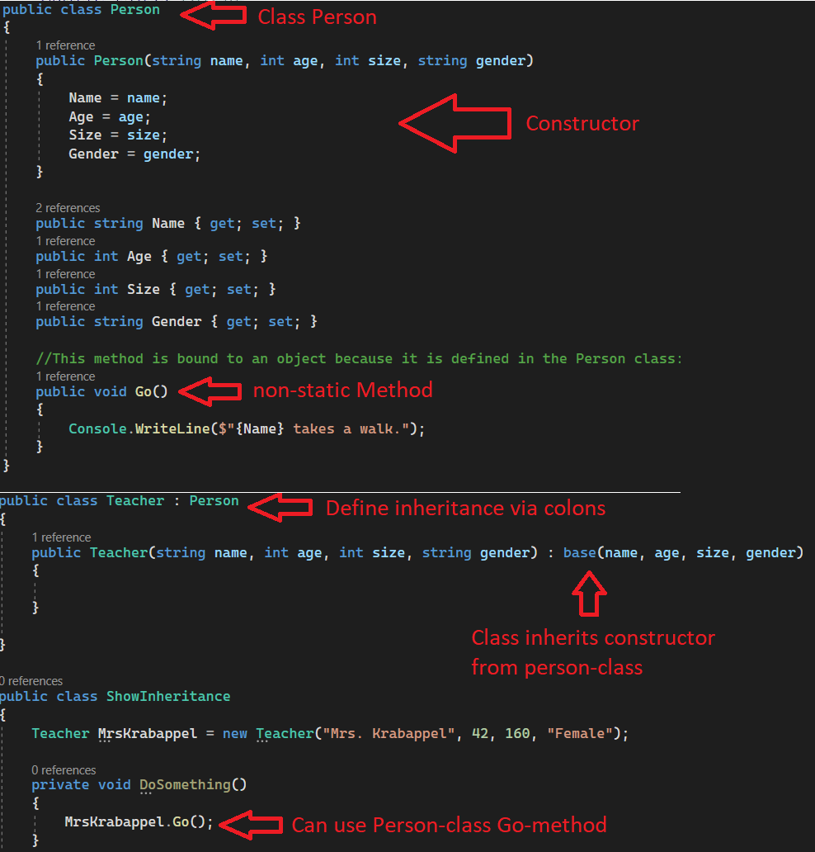
Inheritance
What Is Inheritance – How to use constructors?

Slide 22
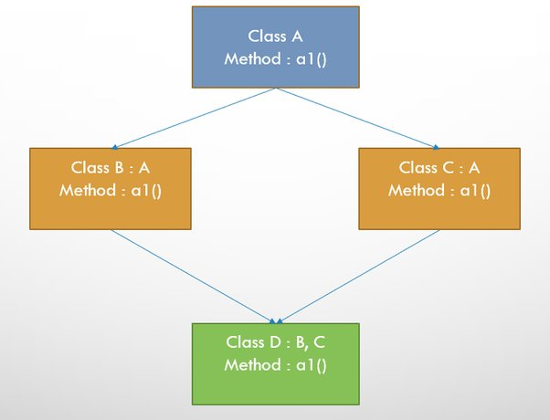
Inheritance
What Is Inheritance – can we have multiple inheritance? NO!
“Diamond Problem”:

Slide 23
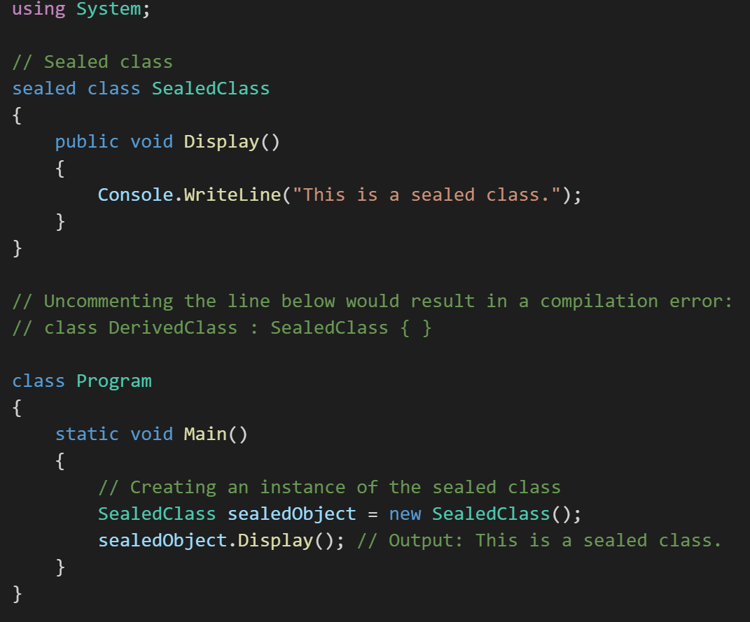
Inheritance
What Is Inheritance – how can we prevent a class from being extended or inherited from? sealed class

Slide 24
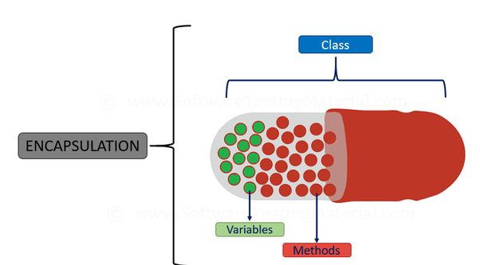
Encapsulation
- What Is Encapsulation?
Encapsulation is a process of binding data members (variables, properties) and member functions (methods) together. In object-oriented programming language we achieve encapsulation through Class.
Real-Life Example Of Encapsulation is the Capsule. Capsule binds all chemical contents required for curing a specific disease together just like the class which binds data members and member functions.

Slide 25
Encapsulation
In C#, encapsulation is achieved by using access modifiers to specify the visibility and accessibility of class members. The access modifiers available in C# are: Public, Private, Protected, Internal and Protected Internal
Public: Members declared as public can be accessed from anywhere, both within the class and from other classes.
Private: Members declared as private are only accessible within the same class. They cannot be accessed from any other class.
Protected: Members declared as protected are accessible within the same class and its subclasses (derived classes). They are not accessible from outside the class hierarchy.
Internal: Members declared as internal are accessible within the same assembly (a compiled unit of code). They are not accessible from outside the assembly.
Protected Internal: Members declared as protected internal are accessible within the same assembly and its subclasses. They can also be accessed from outside the assembly by classes that inherit from the declaring class.

Slide 26
Encapsulation
- Benefits/Advantages Of Using Encapsulation
Encapsulation As Information Hiding Mechanism
The contents (or data members) of the object are generally hidden from the outside world (By simply making the data members private) which is nothing but information hiding.
Typically, only the object's own methods can directly inspect or manipulate its fields. So the outside world only knows what a class does (Through the member functions) but doesn't know what are its data members and how that class does a specific task.
Hiding the internals of the object or allowing access to it through only a member function protects object integrity by preventing users from setting the internal data or the component in such a way that may lead to an invalid or inconsistent state of the object.

Slide 27
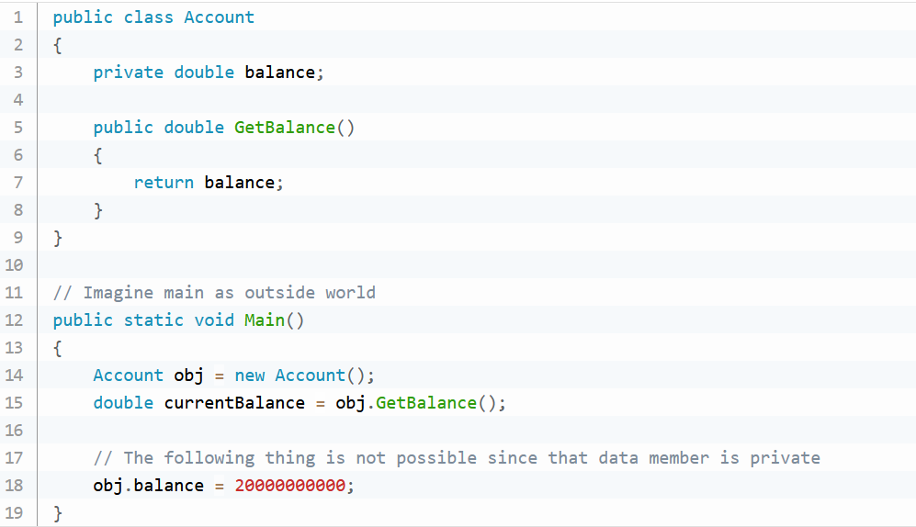
Encapsulation
- What Is Encapsulation?

Slide 28
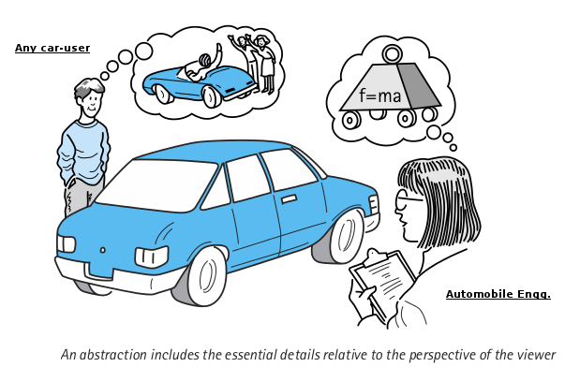
Abstraction
What Is Abstraction?
Abstraction is "To represent the essential feature without representing the background details.“
Abstraction lets you focus on what the object does instead of how it does it.
Abstraction provides a generalized view of your classes or objects by providing relevant information.
Abstraction is the process of hiding the working style of an object and showing the information about an object understandably.

Slide 29
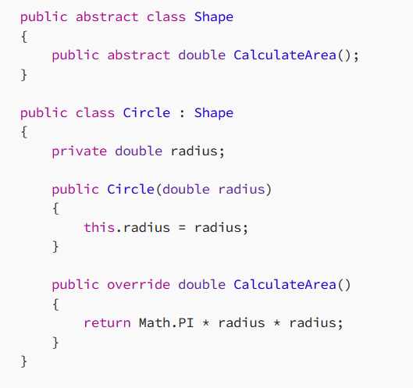
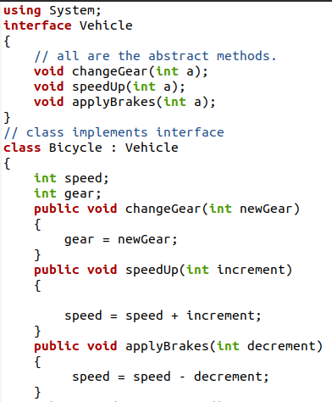
Abstraction
What Is Abstraction?
Abstraction involves simplifying complex systems by breaking them down into smaller, manageable parts.
Abstract classes and interfaces provide a way to define common behavior without specifying implementation details.
An abstract class in C# is a class that cannot be instantiated and can only be used as a superclass for other classes. It may contain both abstract and non-abstract methods.

Slide 30
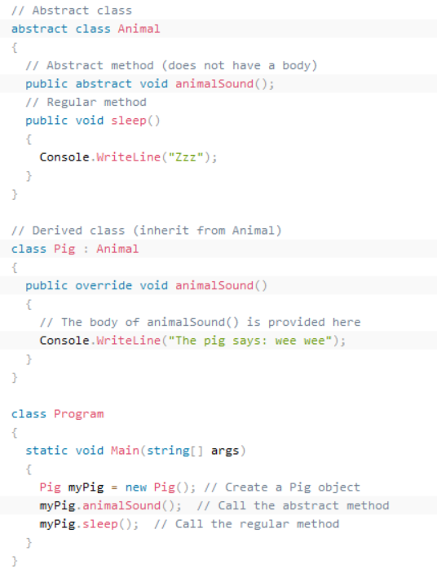
Abstraction
What Is Abstraction?

Slide 31
Abstraction
Real-world Example of Abstraction
Suppose you have an object Mobile Phone.
Suppose you have three mobile phones as in the following:
Nokia 1400 (Features: Calling, SMS)
Nokia 2700 (Features: Calling, SMS, FM Radio, MP3, Camera)
BlackBerry (Features: Calling, SMS, FM Radio, MP3, Camera, Video Recording, Reading E-mails)
Abstract information (necessary and common information) for the "Mobile Phone" object is that it calls any number and can send an SMS.

Slide 32
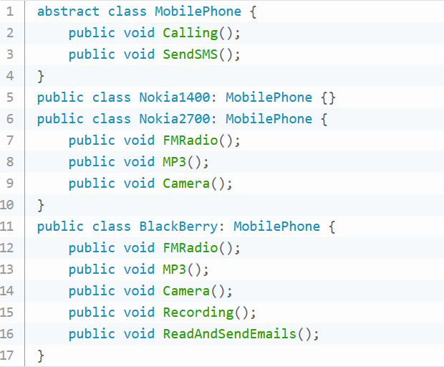
Abstraction
Real-world Example of Abstraction

Slide 33
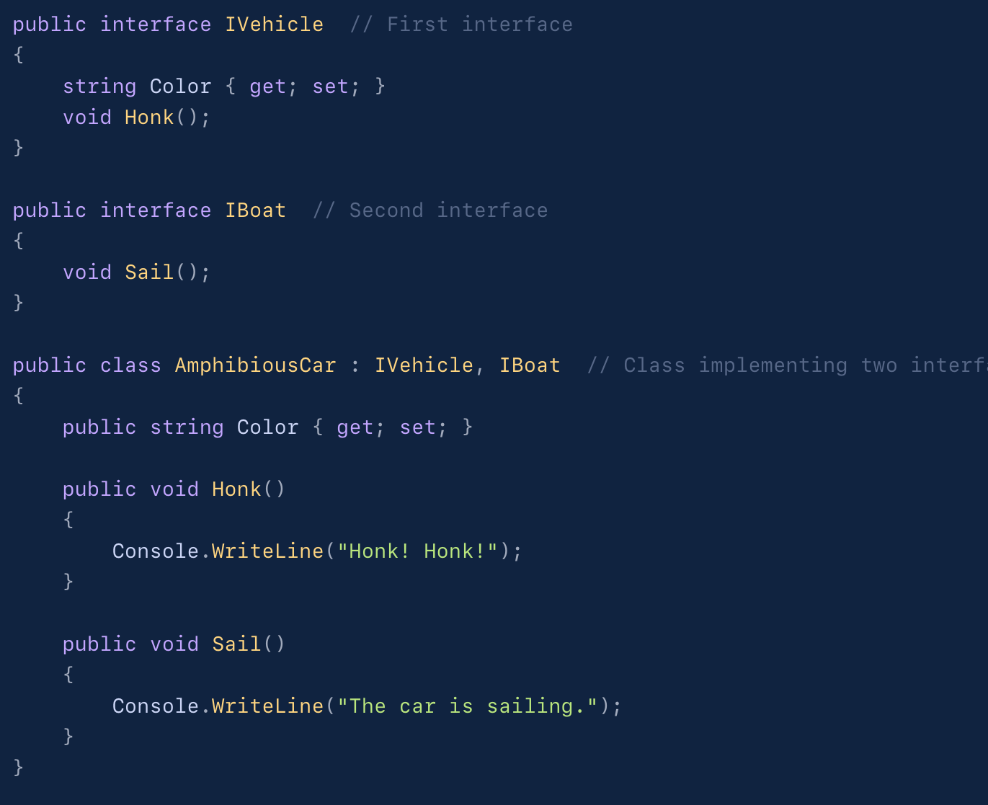
Abstraction
Real-world Example of Abstraction – Multiple Interfaces

Slide 34
Polymorphism
What Is Polymorphism?
Poly means many and Morph means forms (do not use this answer in an interview!)
Polymorphism is the process in which an object or function takes different forms.
One function behaves in different forms.
Real-Life Example Of Polymorphism
A real-life example of Polymorphism is a mobile phone.
It is a single object but it can be used for making calls, listening to music, sending mail, taking pictures, etc (different forms / functions).
Implementation Of Polymorphism In Programming Language
We can implement polymorphism using:
method overloading
method overriding

Slide 35
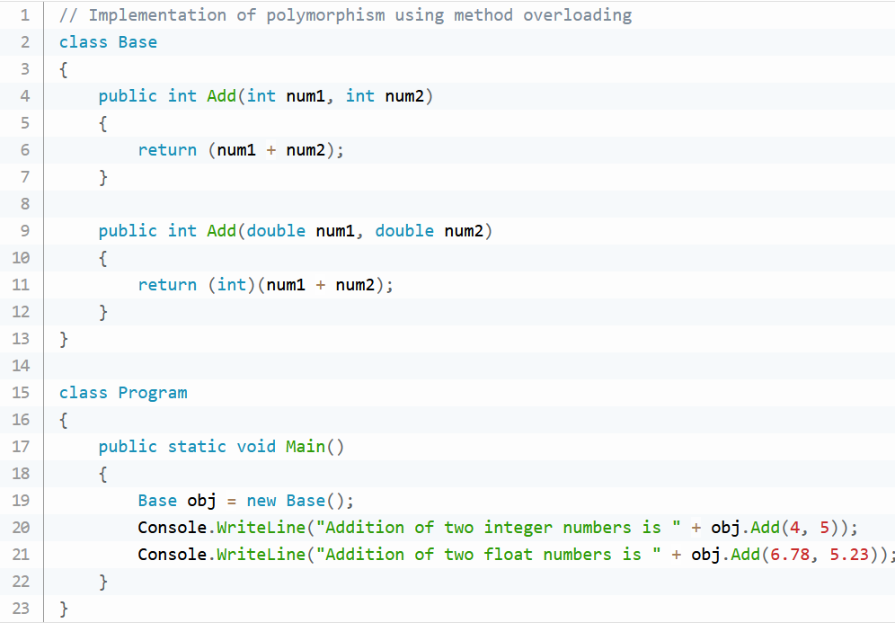
Polymorphism
Method Overloading

Slide 36
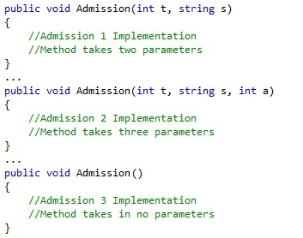
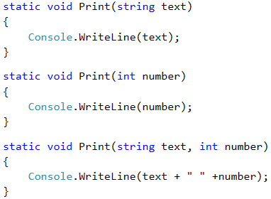
Polymorphism
Method Overloading

Slide 37
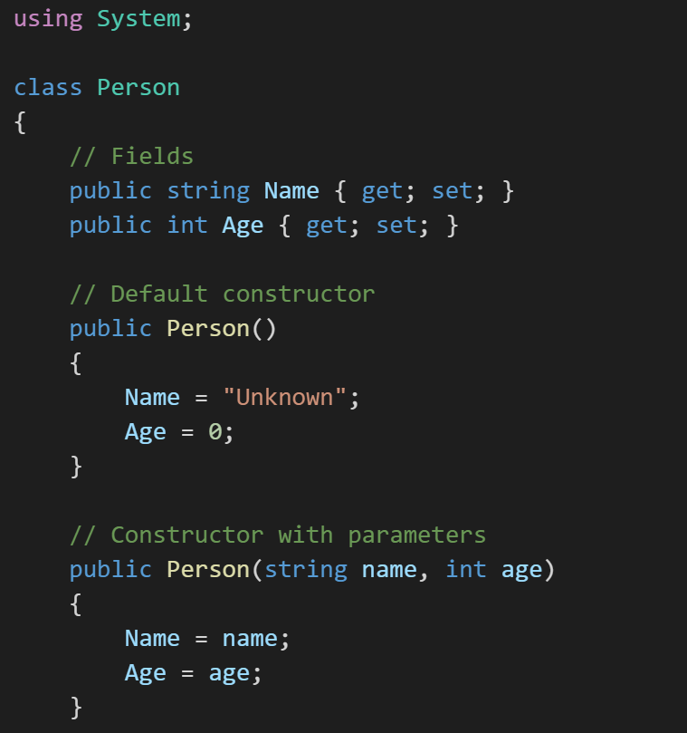
Polymorphism
Method Overloading: constructors can also be overloaded!

Slide 38
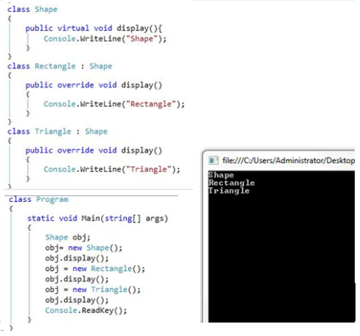
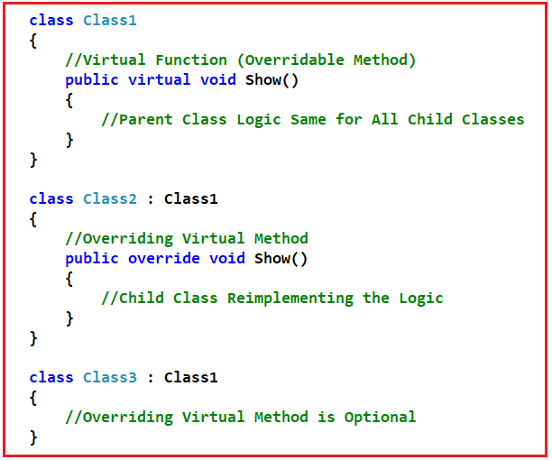
Polymorphism
Method Overriding: virtual & override Keywords

Slide 39
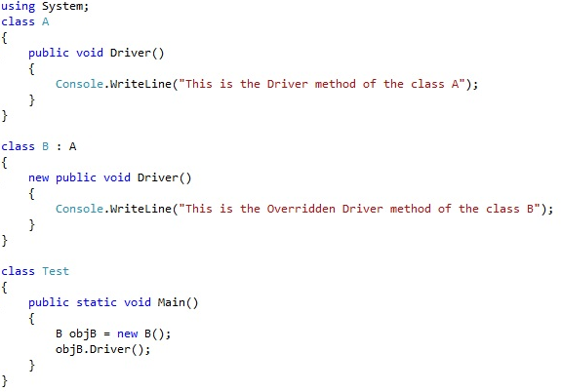
Polymorphism
Method Overriding: new Keyword

Slide 40
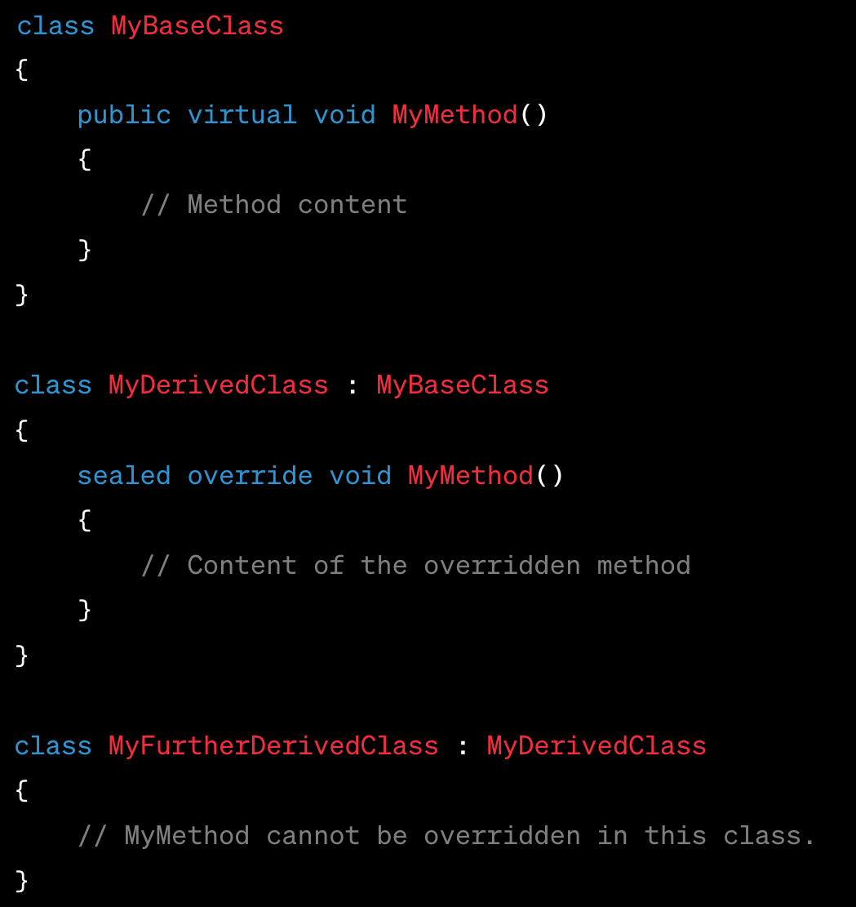
Polymorphism
Method Overriding: how to prevent method overriding?
By default, methods in a base class that are not marked as
Virtual or abstract cannot be overridden in derived classes
In further derived classes, use sealed override Keywords

Slide 41
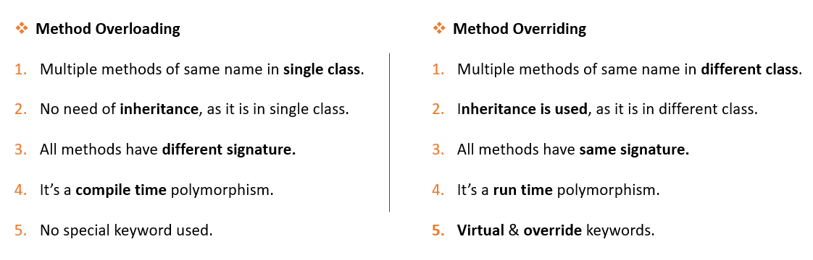
Polymorphism

Slide 42

In Conclusion …

